Slide 1
Literary Style Classification with Deep Linguistic Features
Hyung Jin Kim
Minjong Chung
Wonhong Lee

Slide 2
Introduction
Basic Idea
People in the same professional area share similar literacy style. Is there any way to classify them automatically?
3 different professions on Twitter
Entertainer (Britney Spears)
“I-I-I Wanna Go-o-o by the amazing”
Politician (Barack Obama)
“Instead of subsidizing yesterday’s energy, let’s invest in tomorrow’s.”
IT Guru (Guy Kawasaki)
“Exporting 20,439 photos to try to merge two computers. God help me.”

Slide 3
Approach
We concentrated on extracting as many features as possible from sentence, and selecting the most efficient features from them.
Classifiers
Support Vector Machine (SVM)
Naïve Bayes (NB)

Slide 4
Features
Basic Features
Binary value for each word => Large dimension of feature space
Word Stemming & Removing Stopwords
Used TF-IDF Weighting
Syntactic Features
POS Tag
Using specific classes of POS tag (e.g. only nouns or only verbs, etc.)

Slide 5
Features
Manual Features
Limitation of performance with using only automatically collected features
Manually selected features by human intelligence!
Type of features | Example
Punctuation marks | “awesome!!!!!”
Capitalization | “EVERYONE”
Dates or Years | “Mar 3,1833”
Number or Rates | “10% growth”
Emoticons | “ cool :) “
Retweet (Twitter Specific) | “RT @mjipeo”

Slide 6
Feature Selection
TF-IDF (Term Frequency – Inverse Document Frequency)
Usually used as a importance measure of a term in a document
Information Gain
Tried to measure how we can reduce the uncertainty of labels if we know a word (or feature)
Chi-square
Tried to measure dependency between the feature and the class

Slide 7
Implementation
NLP Libraries
Stanford POS Tagger
JWI WordNet Package developed by MIT for basic dictionary operations
Caching System
Quite amount of time to process
Devised our own caching system to enhance the productivity

Slide 8
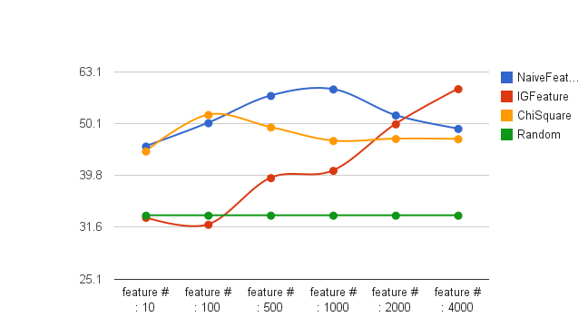
Result
Performance of Various Feature Extractors on SVM
SVM with TF-IDF selection
: 60%
SVM with IG selection
: 58%
SVM with Chi-square
: 52%

Slide 9
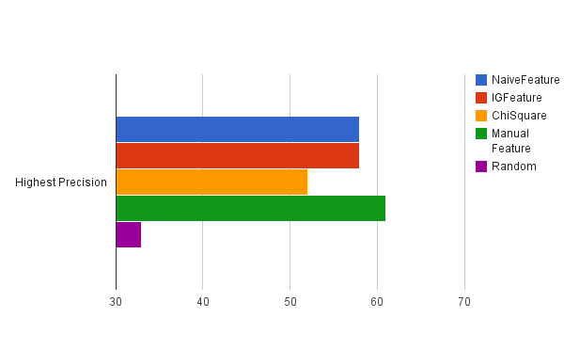
Result
Performance of Manual Feature Extractors on SVM
SVM with manual selection
: 62%

Slide 10
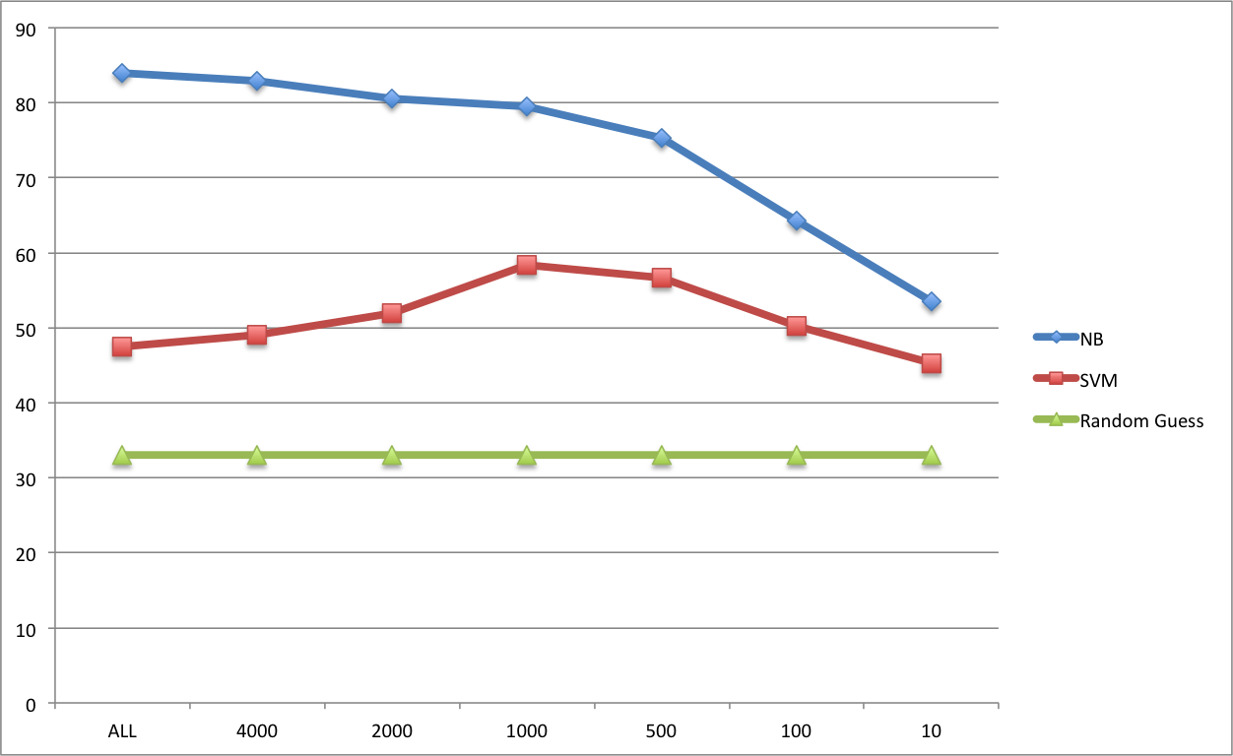
Result
Performance of Classifiers (Naïve Bayes vs. SVM)
NV without feature selection
: 84%
Random guess (benchmark)
: 33%

Slide 11
Conclusion
Naïve Bayes Classifier works surprisingly well without any feature engineering due to appropriate independence assumption
For SVM, selecting proper features is critical to avoid overfitting
Using only noun features works better than general

