Slide 1
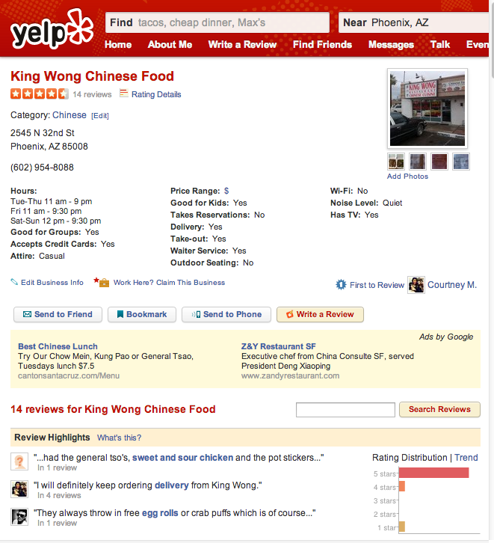
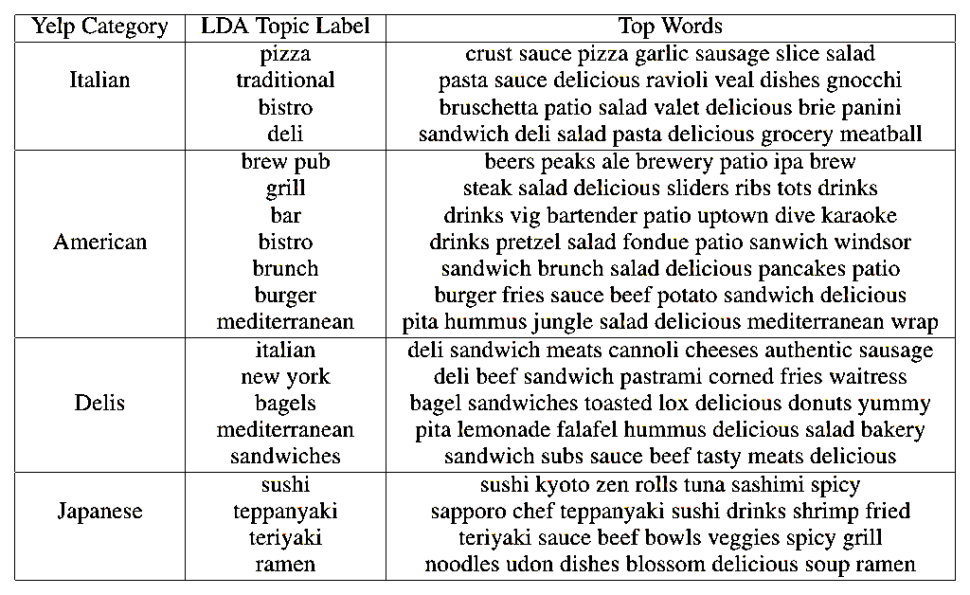

S
T
A
N
F
O
R
D
Generating Recommendation Dialogs by Extracting Information from User Reviews
S
T
A
N
F
O
R
D
Kevin Reschke, Adam Vogel and Dan Jurafsky
Stanford University
Motivation: Dialog-based Restaurant Discovery
1
4
6
Question Generation - Topic Modeling of Cuisine Subcategories
Dynamic Question Selection - Information Gain
Yelp Academic Dataset (May 2013):
- 5,000 Restaurants and Bars
- 160,000 Reviews
- Phoenix, Arizona.
Yelp categories are too coarse:
Italian, American, Deli, Japanese
Goal: Fine-grained subcategories for clarification questions.
Are you thinking sushi, ramen or teppanyaki?
Approach:
Topic Modeling via Latent Dirichlet Allocation on user review text.
i) Learn 10 topics for each top-level category.
ii) Manually assign subcategory names to topics, merging duplicates and discarding junk topics.
iii) Assign restaurants to subcategories based on the topic distribution of their reviews.
Ask questions that maximize Information Gain
Iteratively ask questions about the attribute with the highest entropy.
Each answer narrows down the result set of relevant restaurants.
Infogain( question ) =
-Σ_{answers} p( answer ) log p( answer )
S: What type of food?
U: Japanese.
S: Sushi, ramen,
or teppanyaki?
S: What type of food?
U: Japanese.
S: Do you want a
good drink menu?
I’m not sure what I want.
Sushi
No
I’m not sure what’s available.
Ramen
Yes
Hmm, what should I eat?
teppanyaki
Inefficient Question
Good Question
Simulated Dialogs
7
Q: What kind of place do
you want?
A: American.
Q: What kind of American do
you want: bar, bistro,
standard, burgers, brew
pub, or brunch?
A: Bistro.
Q: Do you want a place with a
good patio.
A: Yes.
Q: What kind of place do you
want?
A: Chinese.
Q: What kind of Chinese place
do you want: buffet, dim
sum, noodles, pan Asian,
Panda Express, sit down, or
veggie?
A: Sit down.
Q: Do you want a place with a
good lunch special?
A: Yes.
Q: What kind of place do you
want?
A: Mexican.
Q: What kind of Mexican place do
you want: dinner, taqueria,
margarita bar, or tortas?
A: Margarita bar.
Q: Do you want a place with a
good patio.
A: Yes.
Recommendation Dialog
2
Question Generation – Review Sentiment Aspects
Conventional
Improved
5
Small Attribute Set
System: What category do you want?
User: Japanese.
System: What is your price range?
User: Cheap.
System: Breakfast, Lunch, or Dinner?
User: Lunch.
System: How about Teriyaki Kitchen at
2028 W Guadalupe Road?
System: What type of food are you
looking for?
User: Japanese.
System: Are you thinking sushi, ramen,
or teppanyaki?
User: I’d like sushi.
System: Are you looking for good fresh
fish.
User: Yes, fresh fish is important.
System: Then I recommend Sushi Ken at
4206 E Chandler Blvd?
Unbounded Attribute Set
Premise: Beyond basic categories, the things that matter for a
restaurant are the things that users rave (or rant) about in reviews.
(+) ( - )
The place had great atmosphere, but the service was slow.
Step 2: Extract Sentiment Aspects:
- High-precision patterns over Stanford dependency parses.
[BIZ + have + adj. + NP]
This place has some really great yogurt and toppings
[NP + be + adj.]
Our pizza was much too jalapeno-y.
iii) [BIZ + positive adj. + for + NP
It’s perfect for a date night.
[Verb + NP]
We loved the fried chicken.
Coarse-grained questions
Fine-grained questions
Fixed Order
Dynamic Ordering
Step 1: Build Domain-specific Sentiment Lexicon:
- Begin with seed words from existing lexicons
- Propagate polarity over coordination graph
Sebo is serving interesting and high-quality fish.
=> polarity(‘interesting) == polarity(‘high-quality’)
8
Results
Sample of most frequent Sentiment Aspect extractions:
Evaluate Question Generation and Selection using simulated dialogs.
Average Recall: How well does the result set produced by
a dialog match the user’s preferences?
Key Observations:
i) Information Gain (All, Subcat, Yelp) outperforms
random question selection (Random).
ii) Cuisine Subcategories (Subcat) boost recall in shorter
dialogs.
iii) Adding Sentiment Aspects (All) improves longer
dialogs.
Two-part Task
Negative Sentiment
institutional, underwhelming, not_nice, burntish, unidentifiable, inefficient, not_attentive, grotesque, confused, trashy, insufferable, grandiose, not_pleasant, timid, degrading, laughable, under-seasoned, dismayed, torn
Positive Sentiment
decadent, satisfied, lovely, stupendous, sizable, nutritious, intense, peaceful, not_expensive, elegant, rustic, fast, affordable, efficient, congenial, rich, not_too_heavy, wholesome, bustling, lush
3
Chinese: +beef +egg roll +sour soup +orange chicken +noodles +crab puff +egg drop soup +dim sum +fried rice Japanese: +rolls +sushi rolls +wasabi +sushi bar +salmon +chicken katsu +crunch +green tea +sake selection +oysters +drink menu +sushi selection +quality Mexican: +salsa bar +burritos +fish tacos +guacamole +enchiladas +hot sauce + carne asade +horchata +breakfast burritos +green salsa +tortillas +quesadillas
Identify Questions To Ask Users
Approach:
Extract aspects from user reviews:
a) Topic Modeling
b) Sentiment Aspects
Choose Relevant Questions for Interactive Dialog
Approach:
Select maximally informative
questions by computing information
gain at each dialog step.
Thanks to the anonymous reviewers and the Stan- ford NLP group for helpful suggestions. The authors also gratefully acknowledge the support of the Nuance Foundation, the Defense Advanced Research Projects Agency (DARPA) Deep Exploration and Filtering of Text (DEFT) Program under Air Force Research Laboratory (AFRL) prime contract no. FA8750-13-2-0040, ONR grants N00014-10-1-0109 and N00014-13-1-0287 and ARO grant W911NF-07-1-0216, and the Center for Advanced Study in the Behavioral Sciences.

