Slide 1

Effective Approaches to Attention-based Neural Machine Translation
Thang Luong
EMNLP 2015
Joint work with: Hieu Pham and Chris Manning.

Slide 2
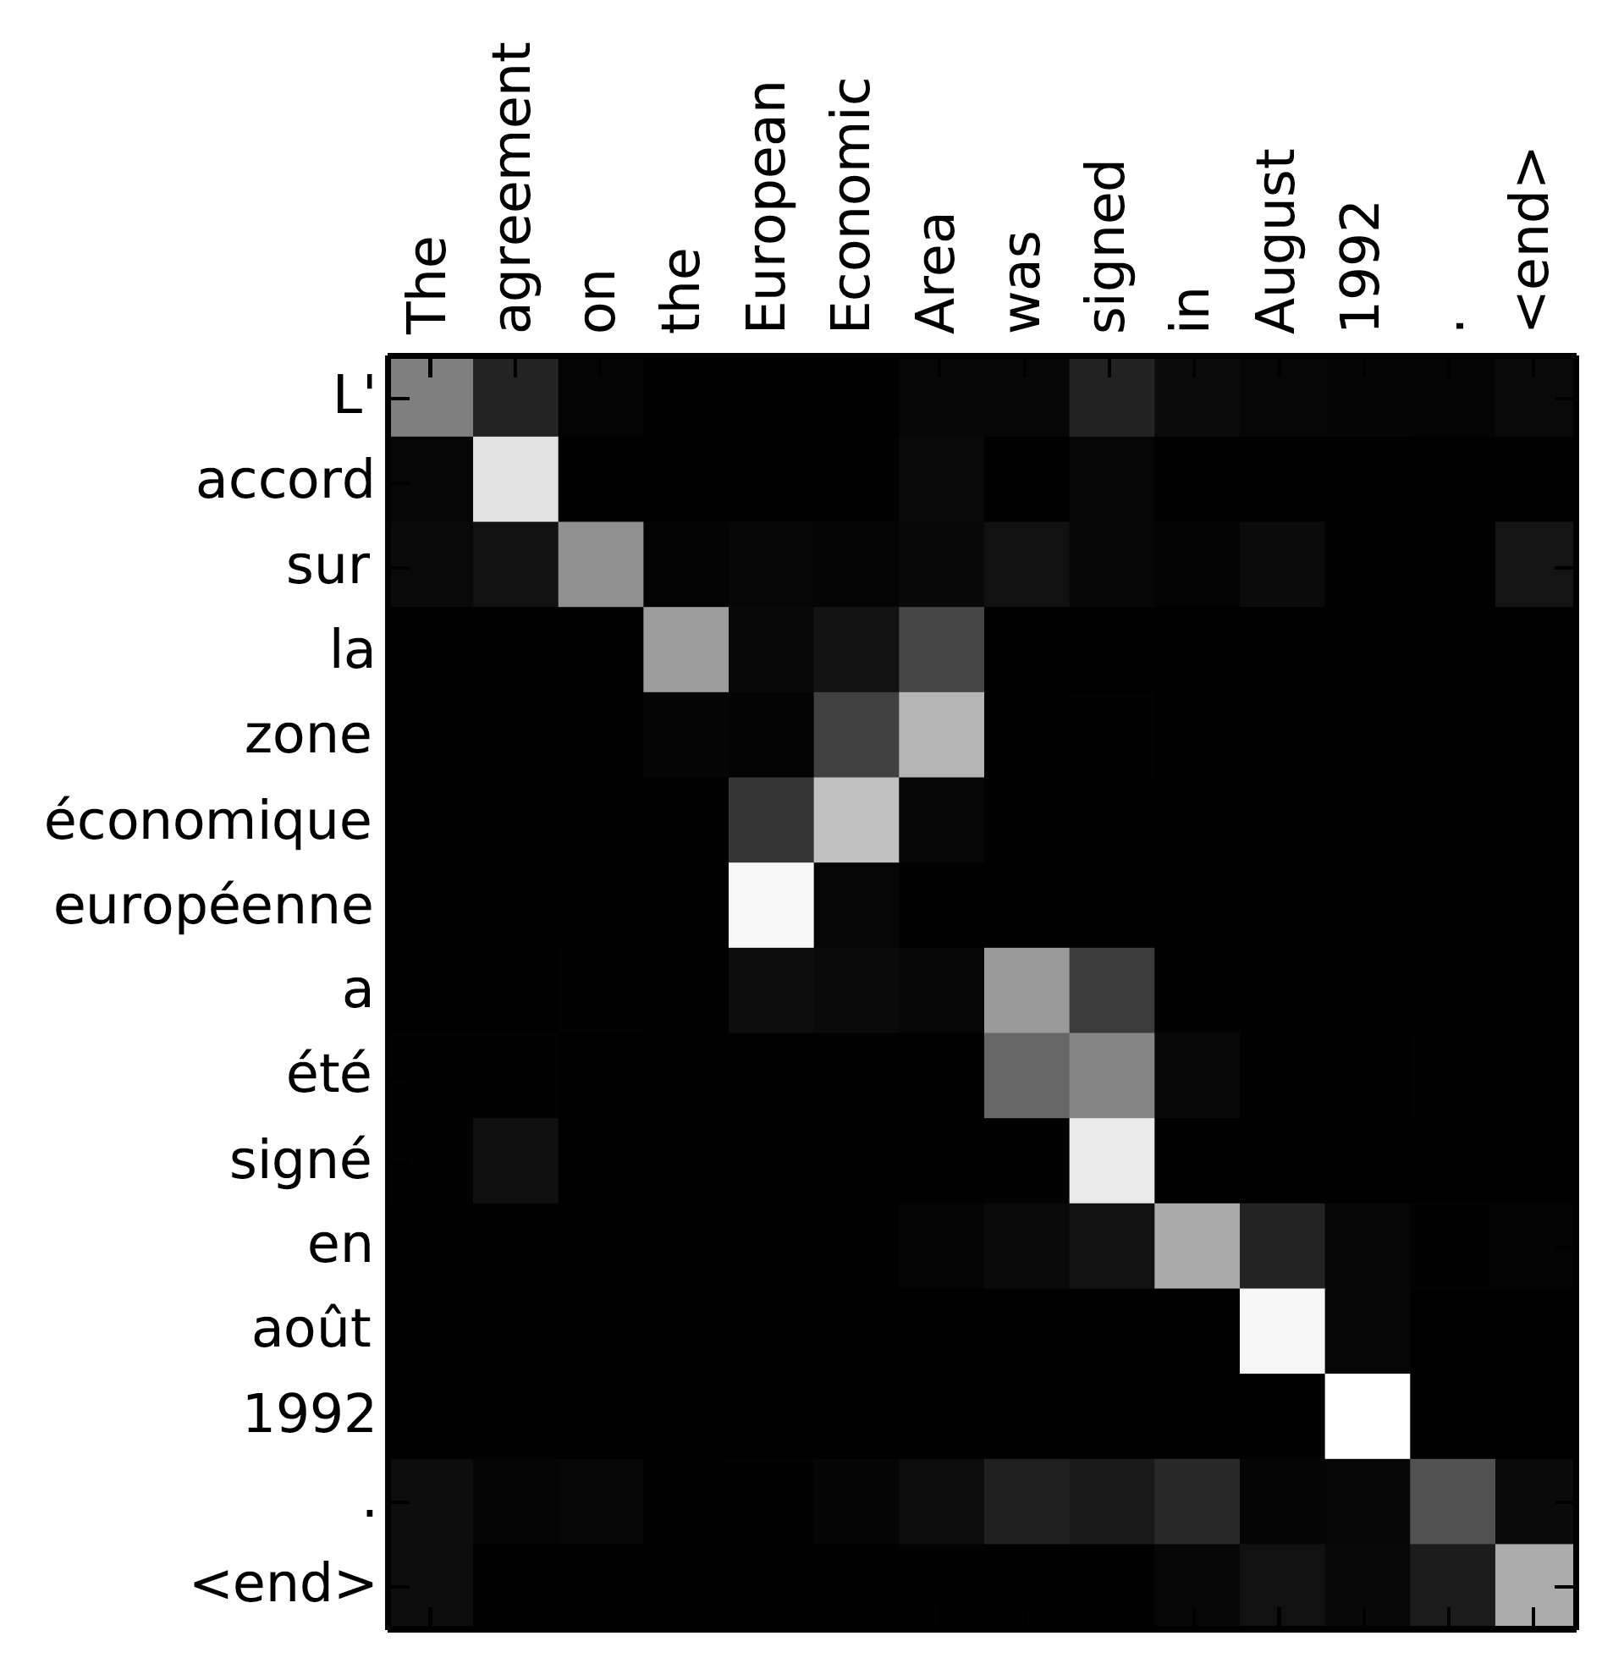
Neural Machine Translation
Attention Mechanism
(Sutskever et al., 2014)
(Bahdanau et al., 2015)
Recent innovation in deep learning:
Control problem (Mnih et al., 14)
Speech recognition (Chorowski et al., 14)
Image captioning (Xu et al., 15)
New approach: recent SOTA results
English-French (Luong et al., 15. Our work.)
English-German (Jean et al., 15)
Propose a new and better attention mechanism.
Examine other variants of attention models.
Achieve new SOTA results WMT English-German.

Slide 3
Neural Machine Translation (NMT)
Big RNNs trained end-to-end.
Notes:
Researchers at Google & Montreal develop a new approach for MT
What is NMT?
A large neural network trained end-to-end.
Reads the entire source sentence.
Produces a translation one word at a time.
Advantages
Input sequence, output sequence
Generalization: source-conditioned LMs.
30, 50-gram LMs
Dimensionality reduction: no gigantic PTs or LMs.
Simple beam-search decoder.

Slide 4
Neural Machine Translation (NMT)
Big RNNs trained end-to-end.
Notes:
Researchers at Google & Montreal develop a new approach for MT
What is NMT?
A large neural network trained end-to-end.
Reads the entire source sentence.
Produces a translation one word at a time.
Advantages
Input sequence, output sequence
Generalization: source-conditioned LMs.
30, 50-gram LMs
Dimensionality reduction: no gigantic PTs or LMs.
Simple beam-search decoder.

Slide 5
Neural Machine Translation (NMT)
Big RNNs trained end-to-end.
Notes:
Researchers at Google & Montreal develop a new approach for MT
What is NMT?
A large neural network trained end-to-end.
Reads the entire source sentence.
Produces a translation one word at a time.
Advantages
Input sequence, output sequence
Generalization: source-conditioned LMs.
30, 50-gram LMs
Dimensionality reduction: no gigantic PTs or LMs.
Simple beam-search decoder.

Slide 6
Neural Machine Translation (NMT)
Big RNNs trained end-to-end.
Notes:
Researchers at Google & Montreal develop a new approach for MT
What is NMT?
A large neural network trained end-to-end.
Reads the entire source sentence.
Produces a translation one word at a time.
Advantages
Input sequence, output sequence
Generalization: source-conditioned LMs.
30, 50-gram LMs
Dimensionality reduction: no gigantic PTs or LMs.
Simple beam-search decoder.

Slide 7
Neural Machine Translation (NMT)
Big RNNs trained end-to-end.
Notes:
Researchers at Google & Montreal develop a new approach for MT
What is NMT?
A large neural network trained end-to-end.
Reads the entire source sentence.
Produces a translation one word at a time.
Advantages
Input sequence, output sequence
Generalization: source-conditioned LMs.
30, 50-gram LMs
Dimensionality reduction: no gigantic PTs or LMs.
Simple beam-search decoder.

Slide 8
Neural Machine Translation (NMT)
Big RNNs trained end-to-end: encoder-decoder.
Notes:
Researchers at Google & Montreal develop a new approach for MT
What is NMT?
A large neural network trained end-to-end.
Reads the entire source sentence.
Produces a translation one word at a time.
Advantages
Input sequence, output sequence
Generalization: source-conditioned LMs.
30, 50-gram LMs
Dimensionality reduction: no gigantic PTs or LMs.
Simple beam-search decoder.

Slide 9
Neural Machine Translation (NMT)
Big RNNs trained end-to-end: encoder-decoder.
Notes:
Researchers at Google & Montreal develop a new approach for MT
What is NMT?
A large neural network trained end-to-end.
Reads the entire source sentence.
Produces a translation one word at a time.
Advantages
Input sequence, output sequence
Generalization: source-conditioned LMs.
30, 50-gram LMs
Dimensionality reduction: no gigantic PTs or LMs.
Simple beam-search decoder.

Slide 10
Neural Machine Translation (NMT)
Big RNNs trained end-to-end: encoder-decoder.
Notes:
Researchers at Google & Montreal develop a new approach for MT
What is NMT?
A large neural network trained end-to-end.
Reads the entire source sentence.
Produces a translation one word at a time.
Advantages
Input sequence, output sequence
Generalization: source-conditioned LMs.
30, 50-gram LMs
Dimensionality reduction: no gigantic PTs or LMs.
Simple beam-search decoder.

Slide 11
Neural Machine Translation (NMT)
Big RNNs trained end-to-end: encoder-decoder.
  Generalize well to long sequences.
  Small memory footprint.
  Simple decoder.
Notes:
Researchers at Google & Montreal develop a new approach for MT
What is NMT?
A large neural network trained end-to-end.
Reads the entire source sentence.
Produces a translation one word at a time.
Advantages
Input sequence, output sequence
Generalization: source-conditioned LMs.
30, 50-gram LMs
Dimensionality reduction: no gigantic PTs or LMs.
Simple beam-search decoder.

Slide 12
Attention Mechanism
Maintain a memory of source hidden states
  Compare target and source hidden states
  Able to translate long sentences.
Notes:
In caption generation: image /text (Xu et al., ’15).

Slide 13
Attention Mechanism
0.6
Maintain a memory of source hidden states
  Compare target and source hidden states
  Able to translate long sentences.
Notes:
In caption generation: image /text (Xu et al., ’15).

Slide 14
Attention Mechanism
0.6
0.2
Maintain a memory of source hidden states
  Compare target and source hidden states
  Able to translate long sentences.
Notes:
In caption generation: image /text (Xu et al., ’15).

Slide 15
Attention Mechanism
0.6
0.2
0.1
Maintain a memory of source hidden states
  Compare target and source hidden states
  Able to translate long sentences.
Notes:
In caption generation: image /text (Xu et al., ’15).

Slide 16
Attention Mechanism
0.6
0.2
0.1
0.1
Maintain a memory of source hidden states
  Compare target and source hidden states
  Able to translate long sentences.
Notes:
In caption generation: image /text (Xu et al., ’15).

Slide 17
Attention Mechanism
0.6
0.2
0.1
0.1
Maintain a memory of source hidden states
  Able to translate long sentences.
  f
No other attention architectures beside (Bahdanau et al., 2015)
Notes:
In caption generation: image /text (Xu et al., ’15).

Slide 18
Our work
A new attention mechanism: local attention
  Use a subset of source states each time.
  Better results with focused attention!
Global attention: use all source states
  Other variants of (Bahdanau et al., 15).
  Known as soft attention (Xu et al., 15).

Slide 19
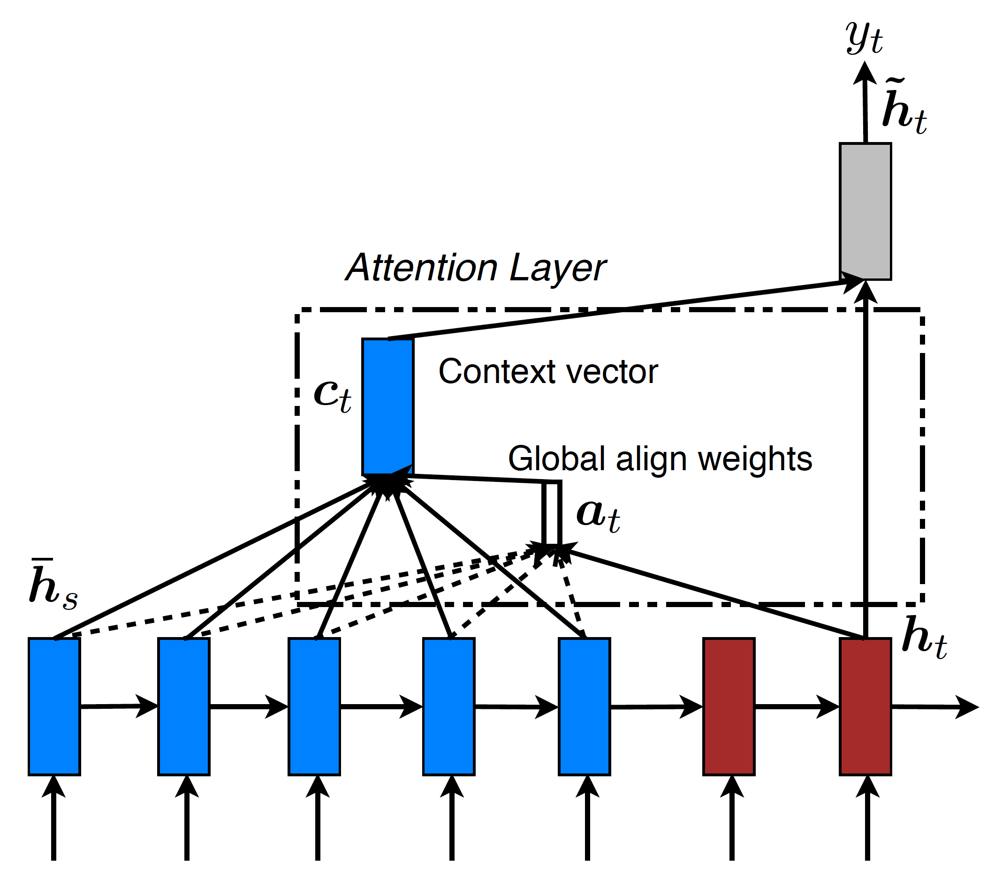
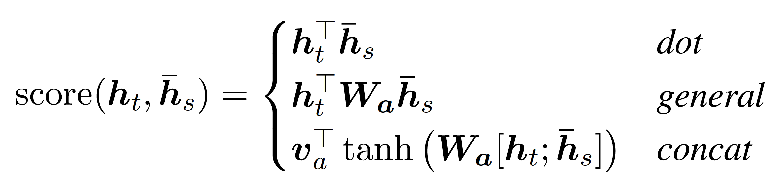
Global Attention
Alignment weight vector:
Notes:
Comparing source / target states

Slide 20
Global Attention
Alignment weight vector:
(Bahdanau et al., 15)
Notes:
Comparing source / target states

Slide 21
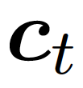
Global Attention
Context vector :
weighted average of source states.
Notes:
Comparing source / target states
If you read the appendix of (Bahdanau et al., 2015) paper, you will agree that the formulation here is simpler.

Slide 22
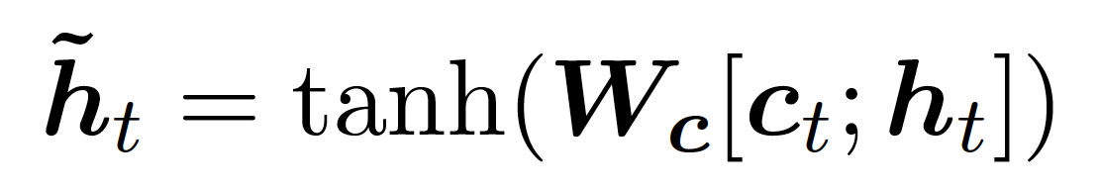
Global Attention
Attentional vector
Notes:
Comparing source / target states
If you read the appendix of (Bahdanau et al., 2015) paper, you will agree that the formulation here is simpler.

Slide 23
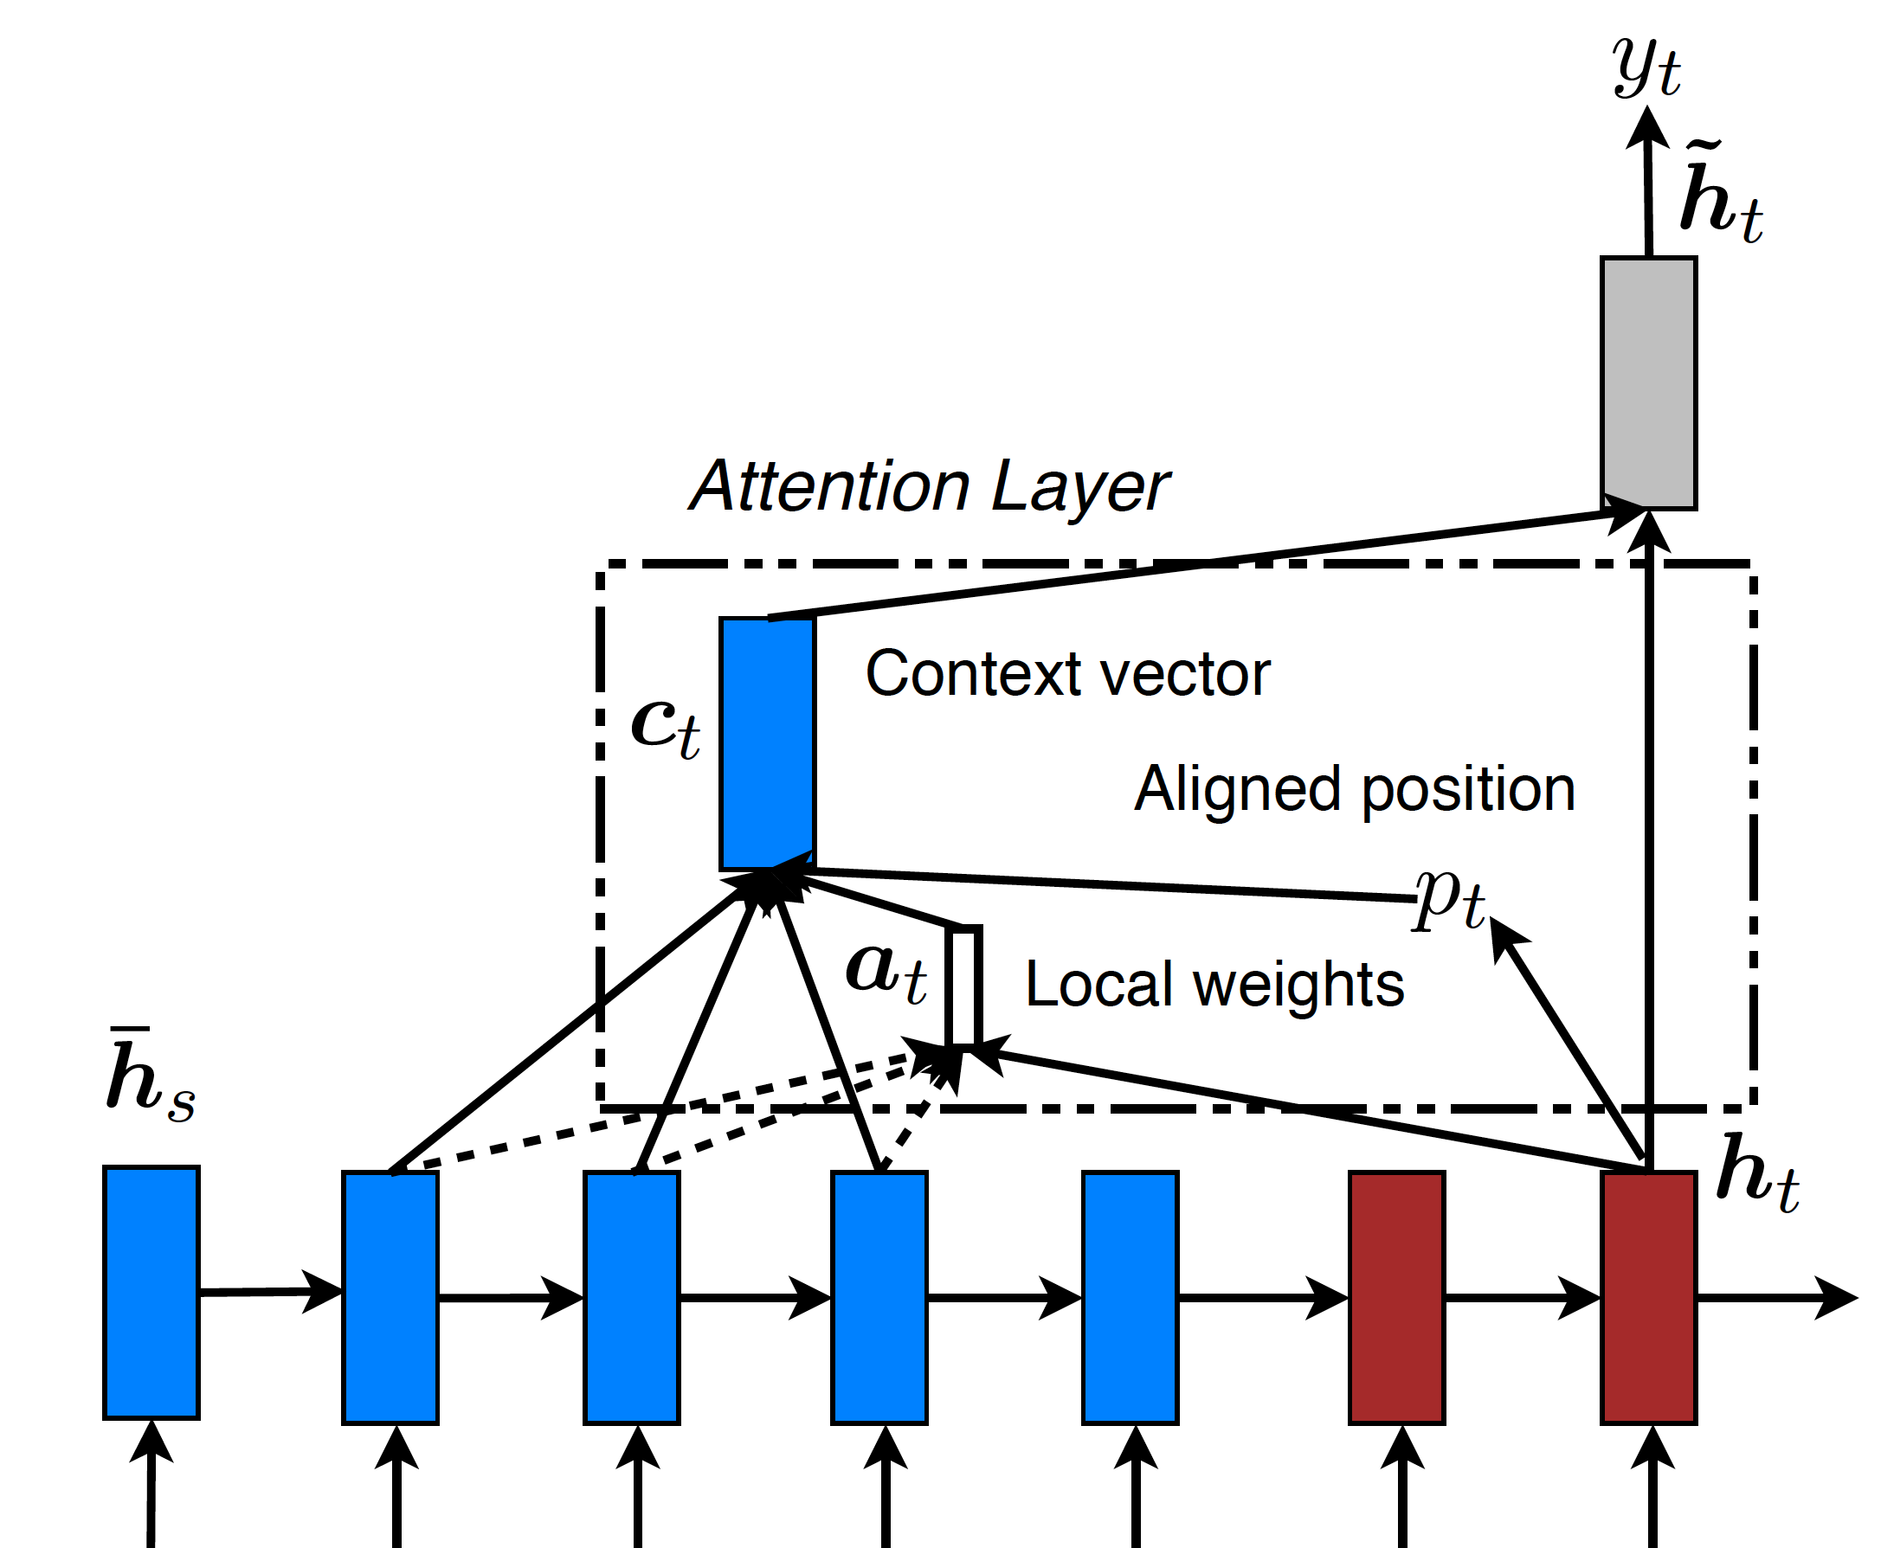

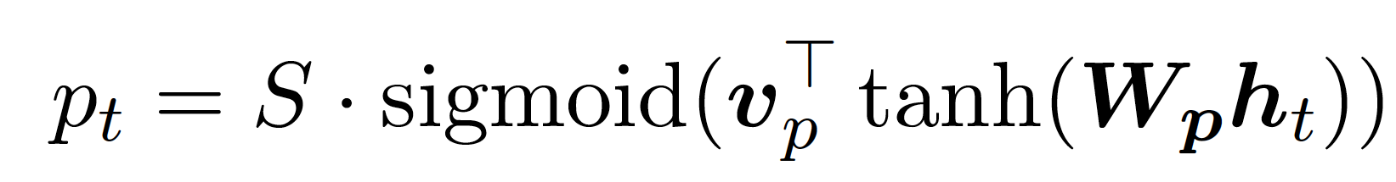
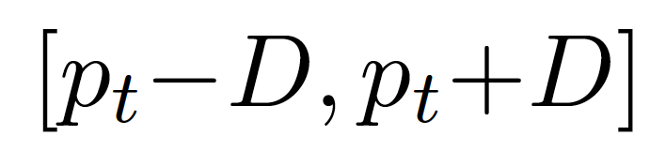
Local Attention
aligned positions?
defines a focused window .
A blend between soft & hard attention (Xu et al., ’15).
Notes:
Aligned positions to define a window
Focused attention & differentiable almost everywhere.
Soft attention: weights applied to all image patches. Similar to the global attention.
Hard attention: attend to one patch of the image at a time

Slide 24
Local Attention (2)
Predict aligned positions:
Real value in [0, S]
Source sentence
How do we learn to the position parameters?
Notes:
Monotonic: compare target hidden states and source hidden states but only restricted to vectors in the window

Slide 25
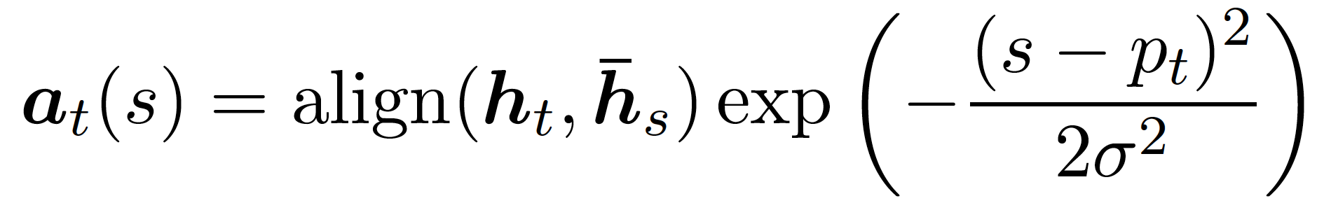
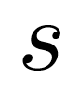
Local Attention (3)
Alignment weights
5.5
2
Like global model: for integer in
  Compute

Slide 26
Local Attention (3)
Truncated Gaussian
Favor points close to the center.

Slide 27
Local Attention (3)
New Peak
Differentiable almost everywhere!

Slide 28
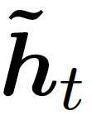
Input-feeding Approach
Need to inform about past alignment decisions.
  Various ways to accomplish this, e.g., (Bahdanau et al., ’15).
  We examine the importance of this connection.
Notes:
Our design: attention decisions are made independently of one another from hidden states at the top.
We know that in standard MT, a coverage set is maintained to keep track of which words have been translated or aligned.

Slide 29
Input-feeding Approach
Extra connections
Feed attentional vectors to the next time steps
  Various ways to accomplish this, e.g., (Bahdanau et al., ’15).
  We examine the importance of this connection.
Notes:
Our design: attention decisions are made independently of one another from hidden states at the top.
We know that in standard MT, a coverage set is maintained to keep track of which words have been translated or aligned.

Slide 30
Experiments
WMT English ⇄ German (4.5M sentence pairs).
Setup: (Sutskever et al., 14, Luong et al., 15)
  4-layer stacking LSTMs: 1000-dim cells/embeddings.
  50K most frequent English & German words

Slide 31
English-German WMT’14 Results
Systems | Ppl | BLEU
Winning system – phrase-based + large LM (Buck et al.) |  | 20.7
Our NMT systems
Base | 10.6 | 11.3
Large progressive gains:
  Attention: +2.8 BLEU Feed input: +1.3 BLEU
BLEU & perplexity correlation (Luong et al., ’15).

Slide 32
English-German WMT’14 Results
Systems | Ppl | BLEU
Winning system – phrase-based + large LM (Buck et al.) |  | 20.7
Our NMT systems
Base | 10.6 | 11.3
Base + reverse | 9.9 | 12.6 (+1.3)
Large progressive gains:
  Attention: +2.8 BLEU Feed input: +1.3 BLEU
BLEU & perplexity correlation (Luong et al., ’15).

Slide 33
English-German WMT’14 Results
Systems | Ppl | BLEU
Winning system – phrase-based + large LM (Buck et al.) |  | 20.7
Our NMT systems
Base | 10.6 | 11.3
Base + reverse | 9.9 | 12.6 (+1.3)
Base + reverse + dropout | 8.1 | 14.0 (+1.4)
Large progressive gains:
  Attention: +2.8 BLEU Feed input: +1.3 BLEU
BLEU & perplexity correlation (Luong et al., ’15).

Slide 34
English-German WMT’14 Results
Systems | Ppl | BLEU
Winning system – phrase-based + large LM (Buck et al.) |  | 20.7
Our NMT systems
Base | 10.6 | 11.3
Base + reverse | 9.9 | 12.6 (+1.3)
Base + reverse + dropout | 8.1 | 14.0 (+1.4)
Base + reverse + dropout + global attn | 7.3 | 16.8 (+2.8)
Large progressive gains:
  Attention: +2.8 BLEU Feed input: +1.3 BLEU
BLEU & perplexity correlation (Luong et al., ’15).

Slide 35
English-German WMT’14 Results
Systems | Ppl | BLEU
Winning system – phrase-based + large LM (Buck et al.) |  | 20.7
Our NMT systems
Base | 10.6 | 11.3
Base + reverse | 9.9 | 12.6 (+1.3)
Base + reverse + dropout | 8.1 | 14.0 (+1.4)
Base + reverse + dropout + global attn | 7.3 | 16.8 (+2.8)
Base + reverse + dropout + global attn + feed input | 6.4 | 18.1 (+1.3)
Large progressive gains:
  Attention: +2.8 BLEU Feed input: +1.3 BLEU
BLEU & perplexity correlation (Luong et al., ’15).

Slide 36
English-German WMT’14 Results
Systems | Ppl | BLEU
Winning sys – phrase-based + large LM (Buck et al., 2014) |  | 20.7
Existing NMT systems (Jean et al., 2015)
RNNsearch |  | 16.5
RNNsearch + unk repl. + large vocab + ensemble 8 models |  | 21.6
Our NMT systems
Global attention | 7.3 | 16.8 (+2.8)
Global attention + feed input | 6.4 | 18.1 (+1.3)
Notes:
Put in context of other work

Slide 37
English-German WMT’14 Results
Systems | Ppl | BLEU
Winning sys – phrase-based + large LM (Buck et al., 2014) |  | 20.7
Existing NMT systems (Jean et al., 2015)
RNNsearch |  | 16.5
RNNsearch + unk repl. + large vocab + ensemble 8 models |  | 21.6
Our NMT systems
Global attention | 7.3 | 16.8 (+2.8)
Global attention + feed input | 6.4 | 18.1 (+1.3)
Local attention + feed input | 5.9 | 19.0 (+0.9)
Local-predictive attention: +0.9 BLEU gain.23.0
Notes:
Local attention with predictive alignments

Slide 38
English-German WMT’14 Results
Systems | Ppl | BLEU
Winning sys – phrase-based + large LM (Buck et al., 2014) |  | 20.7
Existing NMT systems (Jean et al., 2015)
RNNsearch |  | 16.5
RNNsearch + unk repl. + large vocab + ensemble 8 models |  | 21.6
Our NMT systems
Global attention | 7.3 | 16.8 (+2.8)
Global attention + feed input | 6.4 | 18.1 (+1.3)
Local attention + feed input | 5.9 | 19.0 (+0.9)
Local attention + feed input + unk replace | 5.9 | 20.9 (+1.9)
Unknown replacement: +1.9 BLEU
  (Luong et al., ’15), (Jean et al., ’15).
Notes:
Effective in learning alignments for unknown words

Slide 39
English-German WMT’14 Results
Systems | Ppl | BLEU
Winning sys – phrase-based + large LM (Buck et al., 2014) |  | 20.7
Existing NMT systems (Jean et al., 2015)
RNNsearch |  | 16.5
RNNsearch + unk repl. + large vocab + ensemble 8 models |  | 21.6
Our NMT systems
Global attention | 7.3 | 16.8 (+2.8)
Global attention + feed input | 6.4 | 18.1 (+1.3)
Local attention + feed input | 5.9 | 19.0 (+0.9)
Local attention + feed input + unk replace | 5.9 | 20.9 (+1.9)
Ensemble 8 models + unk replace |  | 23.0 (+2.1)
New SOTA!
Notes:
Effective in learning alignments for unknown words

Slide 40
WMT’15 English-Results
English-German Systems | BLEU
Winning system – NMT + 5-gram LM reranker (Montreal) | 24.9
Our ensemble 8 models + unk replace | 25.9
New SOTA!
WMT’15 German-English: similar gains
  Attention: +2.7 BLEU Feed input: +1.0 BLEU
Notes:
A BLEU point better than the neural MT system from Montreal that won the WMT English - German

Slide 41
Analysis
Learning curves
Long sentences
Alignment quality
Sample translations
Notes:
(English-German systems on newstest2014)

Slide 42
Learning Curves
faf
No attention
Attention

Slide 43
Translate Long Sentences
Attention
No Attention

Slide 44
Alignment Quality
Models | AER
Berkeley aligner | 0.32
Our NMT systems
Global attention | 0.39
Local attention | 0.36
Ensemble | 0.34
RWTH gold alignment data
  508 English-German Europarl sentences.
Force decode our models.
Competitive AERs!

Slide 45
Sample English-German translations
src | Orlando Bloom and Miranda Kerr still love each other
ref | Orlando Bloom und Miranda Kerr lieben sich noch immer
best | Orlando Bloom und Miranda Kerr lieben einander noch immer .
base | Orlando Bloom und Lucas Miranda lieben einander noch immer .
Translate names correctly.

Slide 46
Sample English-German translations
src | ′′ We ′ re pleased the FAA recognizes that an enjoyable passenger experience is not incompatible with safety and security , ′′ said Roger Dow , CEO of the U.S. Travel Association .
ref | “ Wir freuen uns , dass die FAA erkennt , dass ein angenehmes Passagiererlebnis nicht im Wider- spruch zur Sicherheit steht ” , sagte Roger Dow , CEO der U.S. Travel Association .
best | ′′ Wir freuen uns , dass die FAA anerkennt , dass ein angenehmes ist nicht mit Sicherheit und Sicherheit unvereinbar ist ′′ , sagte Roger Dow , CEO der US - die .
base | ′′ Wir freuen uns u ̈ber die <unk> , dass ein <unk> <unk> mit Sicherheit nicht vereinbar ist mit Sicherheit und Sicherheit ′′ , sagte Roger Cameron , CEO der US - <unk> .
Translate a doubly-negated phrase correctly
Fail to translate “passenger experience”.
Notes:
Notice attention models can translate Roger Dow vs. Roger Cameron

Slide 47
Sample English-German translations
src | ′′ We ′ re pleased the FAA recognizes that an enjoyable passenger experience is not incompatible with safety and security , ′′ said Roger Dow , CEO of the U.S. Travel Association .
ref | “ Wir freuen uns , dass die FAA erkennt , dass ein angenehmes Passagiererlebnis nicht im Wider- spruch zur Sicherheit steht ” , sagte Roger Dow , CEO der U.S. Travel Association .
best | ′′ Wir freuen uns , dass die FAA anerkennt , dass ein angenehmes ist nicht mit Sicherheit und Sicherheit unvereinbar ist ′′ , sagte Roger Dow , CEO der US - die .
base | ′′ Wir freuen uns u ̈ber die <unk> , dass ein <unk> <unk> mit Sicherheit nicht vereinbar ist mit Sicherheit und Sicherheit ′′ , sagte Roger Cameron , CEO der US - <unk> .
Fail to translate “passenger experience”.
Notes:
Notice attention models can translate Roger Dow vs. Roger Cameron

Slide 48
Sample German-English translations
src | Wegen der von Berlin und der Europa ̈ischen Zentralbank verha ̈ngten strengen Sparpolitik in Verbindung mit der Zwangsjacke , in die die jeweilige nationale Wirtschaft durch das Festhal- ten an der gemeinsamen Wa ̈hrung geno ̈tigt wird , sind viele Menschen der Ansicht , das Projekt Europa sei zu weit gegangen
ref | The austerity imposed by Berlin and the European Central Bank , coupled with the straitjacket imposed on national economies through adherence to the common currency , has led many people to think Project Europe has gone too far .
best | Because of the strict austerity measures imposed by Berlin and the European Central Bank in connection with the straitjacket in which the respective national economy is forced to adhere to the common currency , many people believe that the European project has gone too far .
base | Because of the pressure imposed by the European Central Bank and the Federal Central Bank with the strict austerity imposed on the national economy in the face of the single currency , many people believe that the European project has gone too far .
Translate well long sentences.
Notes:
Notice attention models can translate Roger Dow vs. Roger Cameron

Slide 49
Conclusion
Two effective attentional mechanisms:
  Global and local attention
  State-of-the-art results in WMT English-German.
Detailed analysis:
  Better in translating names.
  Handle well long sentences.
  Achieve competitive AERs.
Code will be available soon: http://nlp.stanford.edu/projects/nmt/
Thank you!

